Slide 1
SD card
+11.1v
Lipo
3000 mAh
IMU
CMPS12
0v
Motor
Rear Left
Motor
Rear Right
Motor
Front Right
Motor
Front Left
Address
0x60
ESC
Rear Left
ESC
Rear Right
ESC
Front Right
ESC
Front Left
SCLK
MISO
MOSI
CS
8
7
6
5
20
SDA
21
SCL
SPI
Arduino MEGA2560
PWM
I2C
13
12
11
10
+7.5V
Li Ion
2600 mAh
RTC
DS1307
0V
Address
0x68
SDA
SCL
50
SPI
51
52
A4
A5
0V
+5V
A8
A9
A10
A11
A12
A13
RC
Throttle
Roll
Pitch
Yaw
Aux1
Aux2

Slide 2
Devices (1/2)
Device | Purpose | Interface
RC-THROTTLE | RC Command | PPM- Interrupt PCINT16/PK0 pin A8
RC-ROLL | RC Command | PPM- Interrupt PCINT17/PK1 pin A9
RC-PITCH | RC Command | PPM- Interrupt PCINT18/PK2 pin A10
RC-YAW | RC Command | PPM- Interrupt PCINT19/PK3 pin A11
RC-AUX1 | RC Command | PPM- Interrupt PCINT20/PK4 pin A12
RC-AUX2 | RC Command | PPM- Interrupt PCINT21/PK5 pin A13
Motor Front Left | ESC Motor | PWM using servo lib pin 5
Motor Front Right | ESC Motor | PWM using servo lib pin 6
Motor Rear Right | ESC Motor | PWM using servo lib pin 7
Motor Rear Left | ESC Motor | PWM using servo lib pin 8

Slide 3
Devices (2/2)
Device | Purpose | Interface
IMU CMPS12 | Control | I2C 0X60
SD Card | Logging | SPI
RTC DS1307 | Logging | I2C 0x68
MEGA2560 built in Led | Monitor | Digital pin 13

Slide 4
Motors
# | Position | Pin | Pin #
0 | Front Left | Motor1Pin | 5
1 | Front Right | Motor2Pin | 6
2 | Rear Right | Motor3Pin | 7
3 | Rear Left | Motor4Pin | 8

Slide 5
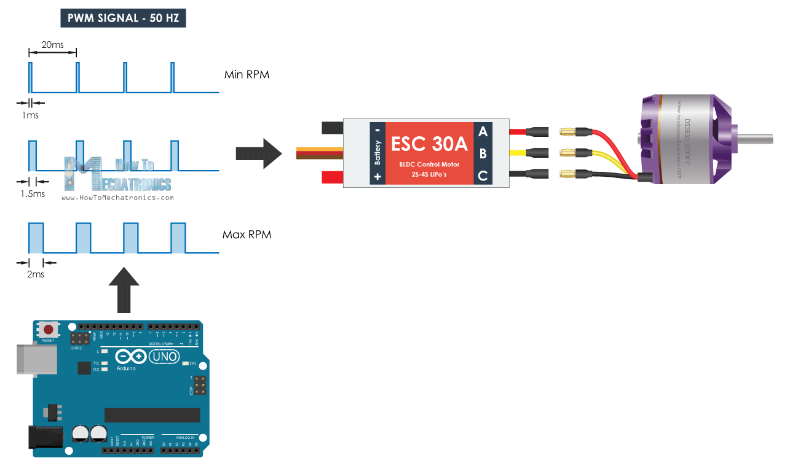
ESC PWM
Configured using BHELI suite with a range 1148 (except motor that need 1156!!!) - 1832.
Firmware 16.6 GH30

Slide 6
Motors rotation (1/2)
Roll
0
1
Front Left
CW
Propeller Reverse black
Front Right
CCW
Propeller green
Pitch
Yaw
Rear Left
CCW
Propeller green
3
2
Rear Right
CW
Propeller Reverse black

Slide 7
Motors Rotation (2/2)
Roll: left/right side tilt.
+ tilted side right, speed 2 Right, slow 2 Left
- left, speed 2 Left, slow 2 Right
Pitch: up/down tilt.
+ tilted skyward, speed 2 Front, slow 2 Rear
- ground, speed 2 Rear, slow 2 Front
Yaw: rotation.
+ Clockwise, speed Front Left & Rear Right, slow Front Right & Rear Left
- Counter clockwise, speed Front Right & Rear Left, slow Front Left & Rear Right
Mix result.
ESC_command = PID = measure - command
#define PIDMIX(X,Y,Z) ESC_command[ROLL]*X + ESC_command[PITCH]*Y + ESC_command[YAW]*Z
motor[0] = PIDMIX(-1,-1,-1); //Front Left Increase speed if ROLL PID < 0 (drone too much tilted right, measure <0) or Increase speed if PITCH PID < 0 (drone too much tilted ground, measure <0) or Increase speed if YAW PID < 0 (drone too much Counter clockwise, measure <0)
motor[1] = PIDMIX(+1,-1,+1); //Front Right Increase speed if ROLL PID > 0 (drone too much tilted left, measure >0) or Increase speed if PITCH PID < 0 (drone too much tilted ground, measure <0) or Increase speed if YAW PID > 0 (drone too much clockwise, measure >0)
motor[2] = PIDMIX(+1,+1,-1); //Rear Right Increase speed if ROLL PID > 0 (drone too much tilted left, measure >0) or Increase speed if PITCH PID > 0 (drone too much tilted skyward, measure >0) or Increase speed if YAW PID < 0 (drone too much Counter clockwise, measure <0)
motor[3] = PIDMIX(-1,+1,+1); //Rear Left Increase speed if ROLL PID < 0 (drone too much tilted right, measure <0) or Increase speed if PITCH PID > 0 (drone too much tilted skyward, measure >0) or Increase speed if YAW PID > 0 (drone too much clockwise, measure >0)

Slide 8
Drone processing (1/3)
This processing usually occurs every 20 ms (samplePeriod), any latency is logged.
RC Command
ROLL, PITCH: range [-45;+45]
YAW: range [-90;+90]
THROTTLE: 0 if < 1.1*MINPPM else value included in [1.1*MINPPM;MAXPPM]
AUX1: 0 if < 0.9*MAXPPM else 1
AUX2: 0 if < 0,9* MAXPPMAUX2 else 1
CMPS12
ROLL, PITCH: range [-90;+90]
YAW: range [0;+359]
PID computed for Roll and Pitch based on RC Command vs CMPS12 measures
error = measure - command
PID = (KP*error) + (KI*sum_error*sampleTime) + (KD*delta_error/ sampleTime)
With
Kp[3] = {0.6, 0.6, 2.4};
Ki[3] = {0.02, 0.02, 0.01}; // values for 50hz (20 ms)
Kd[3] = {12.0, 12.0, 0.0}; // values for 50hz (20 ms)
NB:
The Integral sum_error is capped to _IMax = 5
Low pass filter cut frequency at 20 Hz for the Derivative component, cuts out the high frequency noise that can drive the controller crasy
Initial Yaw (YawInit) is subtracted from Yaw and Yaw is converted from [0;+359] to range [-180;+180]
Considering error max = 20, Integral max = 5 and delta error max = 20 => |PID| < 26.
Call MotorESC_RunMotors
ESC_command[THROTTLE] = RC_command Throttle
ESC_command[ROLL] = PID Roll
ESC_command[PITCH] = PID Pitch
ESC_command[YAW] = PID Yaw

Slide 9
Drone processing (2/3)
#define STOPPWM 1140
#define MINPWM 1148
#define MAXPWM 1832
#define MINPWMTHRO 1250
#define MAXPWMTHRO 1750
#define MAXABSPWMPID 200
#define MAXABSPID 79 // computed based on value of the coeff and max error for PID
MotorESC_RunMotors
if ESC_command[THROTTLE] = 0 => Motors = STOPPWM
else:
// assure consistency between the impact of the throttle and of the PID
throttle = map(ESC_command[THROTTLE], MINPPM, MAXPPM, MINPWMTHRO, MAXPWMTHRO); // to give room for PID ajustement
#define PIDMIX(X,Y,Z) ESC_command[ROLL]*X + ESC_command[PITCH]*Y + ESC_command[YAW]*Z
pid = PIDMIX(-1,-1,-1); //Front Left
_motor[0] = map(pid, -MAXABSPID, MAXABSPID, MINPWMPID, MAXPWMPID) + throttle;
pid = PIDMIX(+1,-1,+1); //Front Right
_motor[1] = map(pid, -MAXABSPID, MAXABSPID, MINPWMPID, MAXPWMPID) + throttle;
pid = PIDMIX(+1,+1,-1); //Rear Right
_motor[2] = map(pid, -MAXABSPID, MAXABSPID, MINPWMPID, MAXPWMPID) + throttle;
pid = PIDMIX(-1,+1,+1); //Rear Left
_motor[3] = map(pid, -MAXABSPID, MAXABSPID, MINPWMPID, MAXPWMPID) + throttle;

Slide 10
Drone processing (3/3)
MotorESC_RunMotors (continued)
For all motors compute:
maxMotor = max (motor[i]- MAXPWM )
minMotor = max (MINPWM - _motor[i])
If maxMotor >0, then Subtract maxMotor from all motors
If minMotor >0, then Add minMotor to all motors
If maxMotor >0 or minMotor >0 , then Cap all motors between MINPWM and MAXPWM

Slide 11
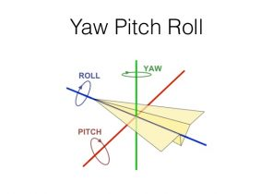
RC
Aux1 (0/1)
Aux2 (0/1)
+45° Pitch
+ Front Left
+ Front Right
+1920 Throttle
+90° Yaw
-90° Yaw
+45° Roll
+ Front Right
+ Rear Right
-45° Roll
+Front Left
+ Rear Left
-45° Pitch
+Rear Right
+ Rear Left
+1100/0 Throttle

Slide 12
Motors
RPM
8 000 rpm max for stable flight ( ie video)
10 000 rpm max for standard flight
12 000 rpm max for race
Using 3S Lipo of 11,1V
8000 tours / 11.1V ≈ 720KV
10000 tours /11.1V ≈ 900KV
12000 tours / 11.1V ≈ 1100KV
I have selected: 920kv

Slide 13
4 Motors Turnigy Aerodrive SK3 de Brushless Outrunner (Hobby King 9192000242-0)
Tension: 6.4 ~ 12.6V (2 ~ 3S LiPoly) RPM / V: 920kv Puissance: 165W Courant max: 17A Courant au repos: 0.95A Résistance: 140mh Shaft (arbre): 3mm L' espacement des trous de boulons: 16 x 19mm Fil de Bolt (boulon): M2 Fiche: 3.5mm Bullet ESC suggérée: 20A Dimensions du moteur: 30 x 28mm Poids: 55g

Slide 14
Propeller
Size
A so-called long propeller will spin slower than a short propeller. Its lift capacity, however, will naturally be more important because of its size. Moreover, its size brings stability in flight. A short propeller will spin faster than a long propeller. It will have less lift but will bring reactivity in flight
Pitch
A high pitch implies a low lift but a high maximum rotation speed. A lower step implies better lift but a limited maximum speed of rotation (by compensation).
I have selected:
size: 10 pouces (25,4 cm) => length frame > 23 cm length min=(25.4+6.5)√2
pitch: 4.5 pouces (10,2 cm)
ClockWise: GWS style slowfly Hélice 10x4.5 Noir (CW)(Hobby King 9329000027)
CounterClockWise: GWS style slowfly Hélice 10x4.5 Green (CCW) (Hobby King 9329000028)

Slide 15
Electronic Speed Controller ESC
Courant max Motor: 17A
ESC 20A
I have selected Turnigy AE-20A Brushless ESC (Hobby king TAE-20A)
Sortie: 20A continue, éclater 25A jusqu'à 10 secondes. Tension d'entrée: 2-4 cellules batterie lithium ou 5-12 cellules de batterie NIMH. BEC: Linéaire 2A @ 5V Transmission Control Signal: système opto couplé. Vitesse maximale: 2 Pole: 210,000rpm 6 Pole: 70,000rpm 12 Pole: 35,000rpm Taille: 50mm (L) * 26mm (W) * 12mm (H). Poids: 19g.
The BEC power is 5v < 7v min needed for Arduino MEGA2560, so I don’t use the BEC.

Slide 16
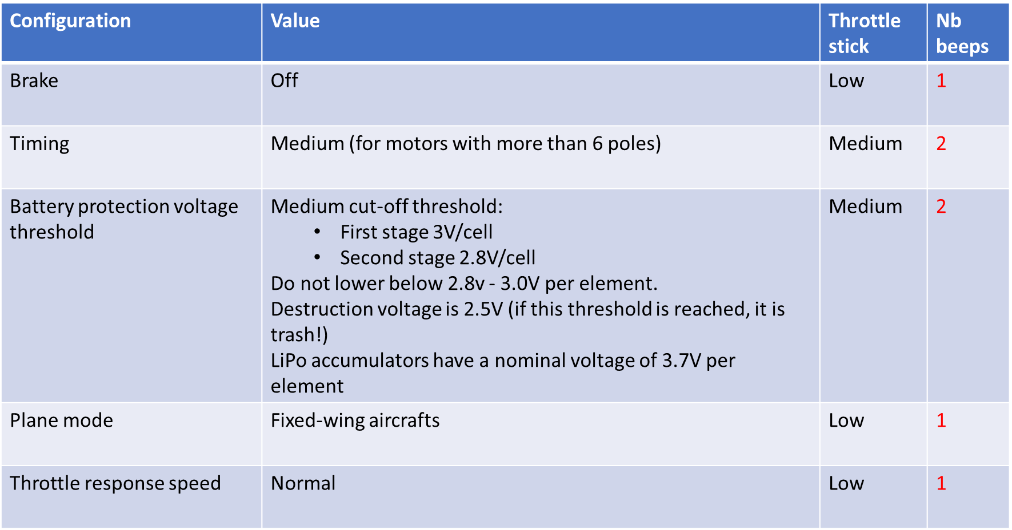
Configuration ESC

Slide 17
Electronic Speed Controller ESC
Courant max Motor: 17A
ESC 20A
I have selected Turnigy MultiStar 20A BLHeli-S Rev16 V3 ESC 2~4S Opto
(Hobby king 9351000086-0)
Constant Current: 20A
Peak Current: 25A
Input Voltage: 2~4S (7.4~14.8V)
BEC: None
Dimensions: 27 x 12mm
Weight: 7.9g

Slide 18
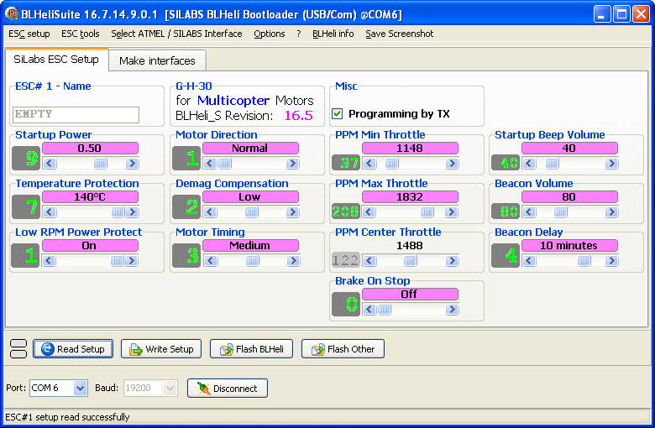
Configuration ESC (except ESC #3)
Run BLHeliSuite16714901\BLHeliSuite
Select SILABS BLHeli Bootloader (USB/Com) in tab ATMEL/SILABS Interface
Select port and baud 19200
Click on Connect
Click on Read Setup
Make changes if needed
Click on Write Setup

Slide 19
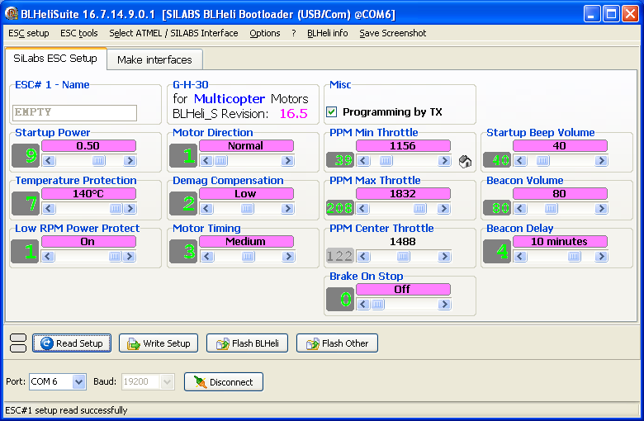
Configuration ESC #3
The only difference with the other ESC is
Min PPM = 1156 instead of 1148 in order to stop the motor when the stick is down

Slide 20
Lipo
3S :3*3,7v =11,1v
4 motors 17A => 68A Max
I have selected LiPo 3S 3000mAh 11.1V 30C not too much heavy with Max discharge = 3*30 = 90A > 68A
Specifications
Type de la batterie LiPO
Capacité batterie 3300 (mAh)
Voltage 11.1 (V)
Courant décharge en continu 30 (C)
Courant de décharge max 60 (C)
Poids 182 (g)
Longueur 103 (mm)
Largeur 33 (mm)
Hauteur 23 (mm)
Type de prise Dean / Tplug
Prise Equilibrage JST-XH
Taux de Charge Max 2 (C)
Nombre d'éléments 3 (S)

Slide 21
Charger Graupner ULTRAMAT 16
Lithium batteries: Lipo (motors) and Lilo (Arduino)
The max. charge voltage for LiPo is 4.2V, for LiIo 4.1V, for LiFe 3.6V. To store the batteries, adjust the charge voltage about 0.4V lower as the maximum charge voltage
At charging/discharging the battery types will be displayed as followed:
LiPo (LiMn) = LP
LiIo = LI
LiFe = LF
Lithium batteries are usually charged at the 1C rate
Ni-MH batteries (RC transmitter)

Slide 22
Receiver
Receiver Henge RP62L
Spécifications:
Size: 49x24x14mm
Weight: 9.2g (with shrink wrap)
Sensitivity: better than 2.0μV
Selectivity: ±8kHz at 65dB down
No. of channels: 1-6
RF technology: Dual tuned RF circuitry
Analog filtering: Dual 4 pole ceramic filter
Digital filtering: DSP filtering with mild algorithm
Modulation: FM/PPM
Shift polarity: Positive or Negative (auto detect)
Case: Shrink wrap
Operating Voltage: 4.8V~6.0VDC
Operating Current: 24mA.

Slide 23
Frame
HobbyKing X550 en fibre de verre Quadcopter Cadre 550mm (9323000036)
Spécifications:
Poids: 312g Largeur: 550mm Trous Motor Bolt: largeur de 19mm
But the frame has been reduced from 10cm, new Largeur: 450mm

Slide 24
Special pins Arduino MEGA2560
Pin Change Interrupt 2 ISR(PCINT2_vect)
For pins PCINT16-PCINT23 (PK0- PK7), PORT K
Use pin A8 to A13 (PCINT16 to PCINT21 )
PCMSK2 – Pin Change Mask Register 2 Bit 2 – PCIF2: clear any outstanding interrupts 2
PCIFR – Pin Change Interrupt Flag Register => Bit 2 – PCIF2: clear any outstanding interrupts 2
PCICR – Pin Change Interrupt Control Register => Bit 2 – PCIE2: enable pin change interrupts 2
SPI
Pin #10: CS
pin #11->pin #51
pin #12->pin #50
pin #13->pin #52

